Slide 1
San Antonio Arrest Data Analysis
By Teresa Luna, Marcela Medina and Brenda Maldonado

Slide 2


Hypothesis: Crime in San Antonio is dependent upon location (zip code), age of offender and time of year.
Dataset: SAPD Record Management System (RMS) arrest data for 2016-2018.
Questions:
1. Are types of crimes more prevalent in one area of San Antonio versus another?
2. Are there any identifiable crime trends annually or monthly?
3. What age group has the highest amount of offenders and what types of crimes do they commit?
Notes:
Are most of the arrests near the downtown area, specifically in or near 78201?
Historically, summer months have been identified as having increases in crime. Is this true for San Antonio?
Is there a difference in arrest offenses for older offenders versus younger offenders?

Slide 3
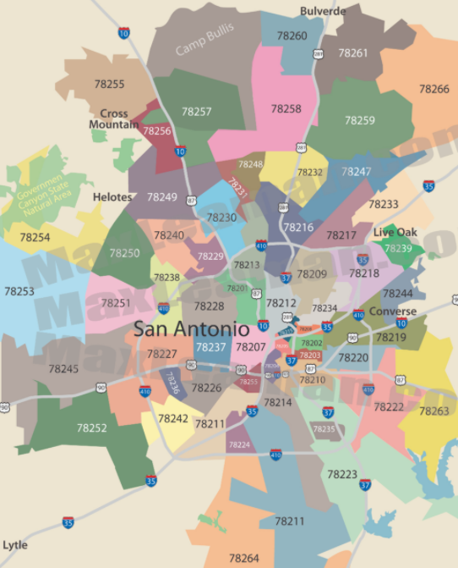
Overall Findings
Top 10 zip codes for arrests are 78205, 78207, 78201, 78228, 78216, 78223, 78227, 78213, 78210, 78237.
There was little to no significant variation in the types of arrests either by month or year.
The number of arrests by age group did reduce as the age of the offender increased.
The age group with the highest arrests were the 20-29 year olds.
More 50-59 year old offenders than 17-19 offenders.
In San Antonio, drug and alcohol violations are the most prevalent.
Notes:
Surprising insight: The top 5 arrest offenses are consistent across every year and every month!

Slide 4
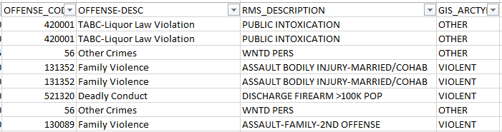
Data Cleanup and Explorations
Data Observations
All necessary data was included in the csv (incident number, months, year, offender age, zip codes, offense description)
There were three types of offense descriptions
Offense desc - specific with 45 categories
RMS desc - most specific with 100+ categories
GIS Arctype - general with only 6 categories
On surface - looked clean
Notes:
Data seemed manageable and had everything we needed
contained more data than needed such as offender DOB, date of arrest, district codes and other descriptions and codes.
We chose the offense description because it included specific descriptions but not more categories than what was needed.

Slide 5
Data Cleanup and Explorations
Discoveries
Missing gender of offenders (81k total)
Missing offender ages with no DOB or well beyond human life expectancy (39 total)
Missing zip codes, inconsistent zip code entry (-XXXX) and a few random zips codes (83k total)
Cleanups
Created df omitting the 39 offenders, clean_offender_df.
Created df omitting missing or incorrect zip codes
Notes:
Discoveries
Omitted gender variable
Omitted only 39 offenders with no age or age of a vampire

Slide 6
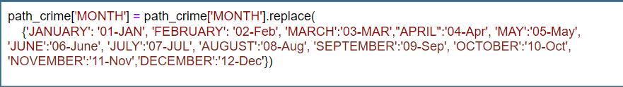
Data Cleanup and Explorations
Headaches
“Other Crimes” arrests were overwhelming and contained mostly ‘wanted people”
ended up omitting “other crimes”
Couldn’t display the months in the correct order
Resolved by creating a dict and replaced the original month column

Slide 7
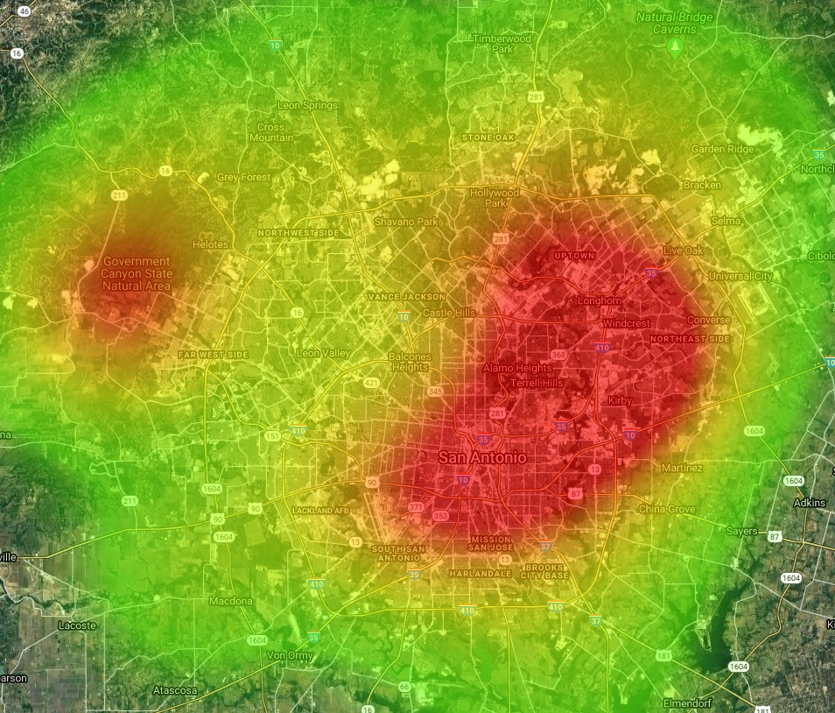
Data Analysis
Q1 - Heat Map 2016-2018
Notes:
.loc, groupby, .replace, value_count(), json(), lat, lng
Used API key requests to generate heat map

Slide 8
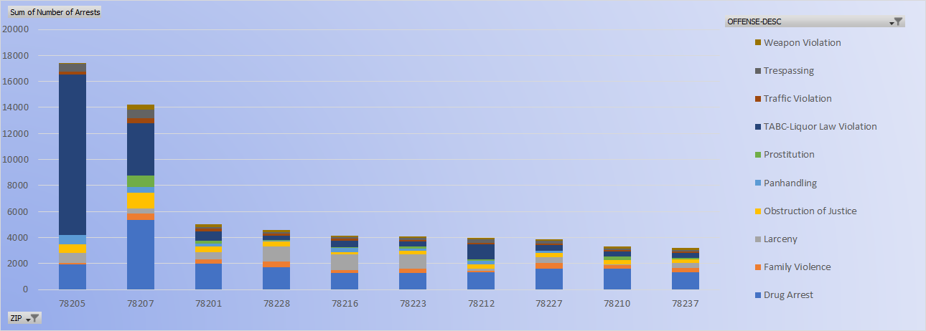
Data Analysis
Q1 - Arrests by Zip code 2016-2018

Slide 9
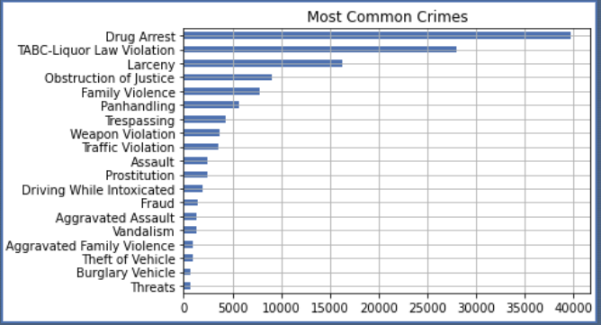
Data Analysis
Q2 - Offenses most Committed 2016-2018

Slide 10
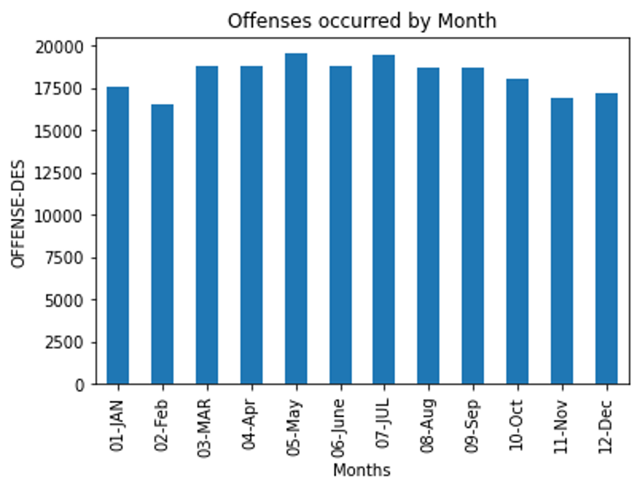
Data Analysis
Q2 - Offenses by Months 2016-2018

Slide 11
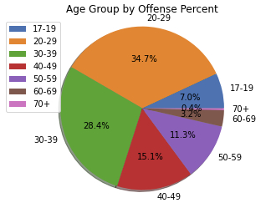
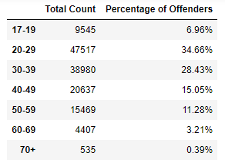
Data Analysis
Q3 - Offender Age Groups

Slide 12
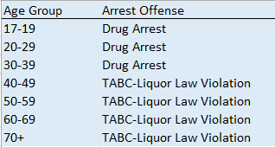
Data Analysis
Q3 - Offender Age Groups

Slide 13

Discussion
Conclusions
There are certain zip codes in which more arrests are made.
The majority of arrests were drug and alcohol related.
There are more arrests made among 20-29 year olds.
Notes:
It was expected that certain zip codes would have more arrests than others due to population density within those codes.

Slide 14

Post Mortem
Additional Questions:
How many of these arrests resulted in actual charges being filed?
Would there have been a difference in the types of arrest offenses between males and females?
Would there have been more arrests in more categories if there were not active task forces?
Notes:
DWI Tasks Forces (Alcohol)
DEA Task Forces (Drugs)

Slide 15
Post Mortem
What would additional years of data show in terms of variance over 10-15 years?
What are the re-arrest rates among these offenders?
What was the length of the case disposition for these arrests?

Slide 16

◤
QUESTIONS?

